Slide 1
Automation from Injection to Painting
Wu wei
2017.3.22

Slide 2
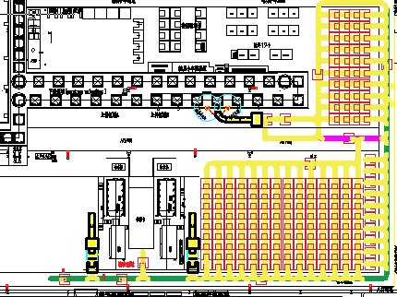
Layout
Full/Empty Bin
Odds Bin
High-rack Loading point
High-rack unloading point
PAGE 2 /17

Slide 3
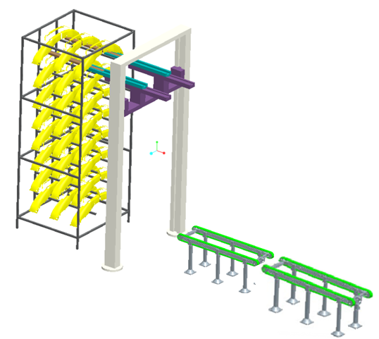
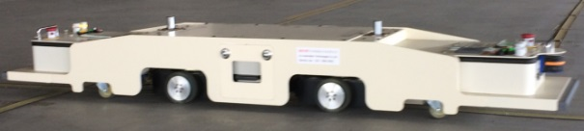
Injection Area Process
Elevator
1.Robot put the bumpers on the conveyor A
2.When 3 bumpers on conveyor A, the move to conveyor B
3.Elevator move the 3 bumpers to high-rack from bottom to top layer.
4.When the rack is full or end of the production, AGV will take the rack to WIP
High-racks
Conveyor B
AGV
Conveyor A
PAGE 3 /17

Slide 4
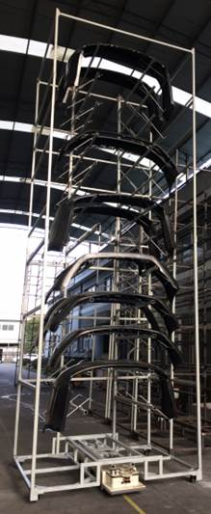
AGV with High-rack
Please see the AGV running video with the high-rack in attached file.
PAGE 4 /17

Slide 5
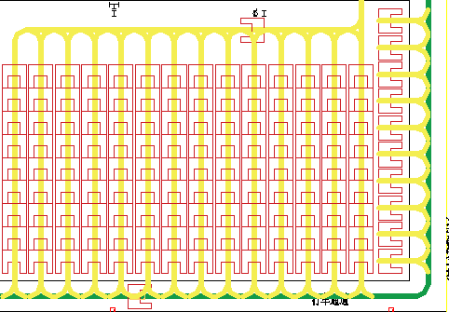
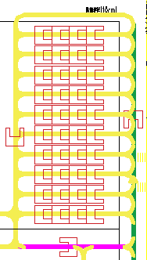
WIP Layout
We will set two types rack path in this case, long and short ,
In order to improve the path utilization rate based on the different volume vehicles.
When we plan to change over the product in IMM, we should produce the former product until the high-rack full, unless we will change the raw material . The injection odd racks will still into the rack path.
Painting side will use the odd racks first to obey the FIFO strictly.
PAGE 5 /17

Slide 6
Rack Path Status
ALL FULL
ALL EMPTY
FULL+EMPTY
EMPTY+ FULL
The rack path will show 4 types status as above graph.
PAGE 6 /17

Slide 7
Part Flow A(Injection parts into WIP)
Path 1
A
A
A
A
A
A
A
A
A
Path 2
A
A
A
A
A
A
Path 3
B
B
B
B
B
B
B
B
B
Path 4
B
B
B
B
B
B
Path 5
A
A
A
A
A
If we have a Product A ’s full rack from IMM 4#, and need a Product A’s empty rack back.
The AGV will carry the rack go to Path 2 and push the front 8 racks move 1position advanced, and then carry the forefront empty rack back to the original position.
PAGE 7 /17

Slide 8
Part Flow B(Injection parts into WIP)
Path 1
A
A
A
A
A
A
A
A
A
Path 2
A
A
A
A
A
A
Path 3
B
B
B
B
B
B
B
B
B
Path 4
B
B
B
B
B
B
Path 5
A
A
A
A
A
If IMM4# change over the product, we will have a Product A ’s odd or full rack into WIP, and IMM4# will produce product B later.
The AGV will carry the rack go to Path 2 and push the front 8 racks move 1position advanced, and then go to Path 4 to carry the forefront empty rack back to the original position.
PAGE 8 /17

Slide 9
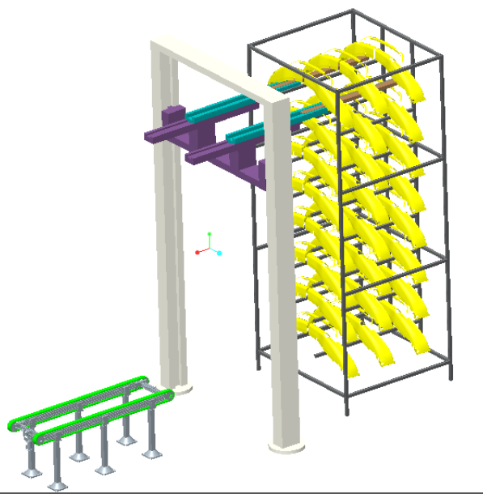
Layout
1.According to the paint-line plan, AGV will carry corresponding rack to the buff area.
2.The elevator will move the bumpers from high-rack to the conveyor from top to bottom layer, and make pre-sequence for the PL load.
3.When the elevator get out the bumpers what PL need, AGV will take the rack to WIP rack path or odd BIN.
4.Operator or robot in the future will pickup the bumper on the conveyor to the jig.
PAGE 9 /17

Slide 10
Part Flow C(Painting rack back to WIP )
Path 1
A
A
A
A
A
A
A
A
A
Path 2
A
A
A
A
A
Path 3
B
B
B
B
B
B
B
B
B
Path 4
B
B
B
B
B
B
Path 5
A
A
A
A
If we have a Product A’s empty rack come from painting loading point , and need a product A’s full rack back.
The AGV will carry the empty rack go to Path 5 and push the front 8 racks move 1position advanced, and then carry the forefront product A’s full rack back to the painting buff position..
PAGE 10 /17

Slide 11
Part Flow D(Painting rack back to WIP )
Path 1
A
A
A
A
A
A
A
A
A
Path 2
A
A
A
A
A
Path 3
B
B
B
B
B
B
B
B
B
Path 4
B
B
B
B
B
B
Path 5
A
A
A
A
If we have a Product A’s empty rack come from painting loading point , and need a product B’s loaded rack back.
The AGV will carry the empty rack go to Path 5 and push the front 8 racks move 1position advanced, and then go to Path 3(if Product B have no odd rack.) to carry the forefront full rack back to the original position.
PAGE 11 /17

Slide 12


THANKS
FOR WATCHING

